Slide 1

6th Grade Math
Unit 11, Lesson 4 Applying Properties of Operations Volume 2, pg. 255

Slide 2


Benchmark
MA.6.AR.1.4
Apply the properties of operations to generate equivalent algebraic expressions with integer coefficients.
volume 2, pg. 255

Slide 3
Integrated Mathematical Thinking and Reasoning Standards
MA.K12.MTR.1.1 Actively participate in effortful learning both individually and collectively.
MA.K12.MTR.4.1 Engage in discussions that reflect on the mathematical thinking of self and others.
MA.K12.MTR.5.1 Use patterns and structure to help understand and connect mathematical concepts.
volume 2, pg. 255

Slide 4

Learning Target
I can apply the associative, commutative, and distributive properties to generate equivalent expressions.
volume 2, pg. 255

Slide 5

Warm-Up
volume 2, pg. 256

Slide 6
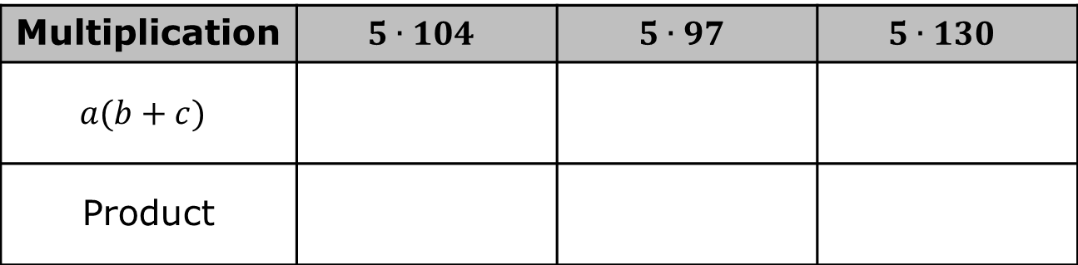
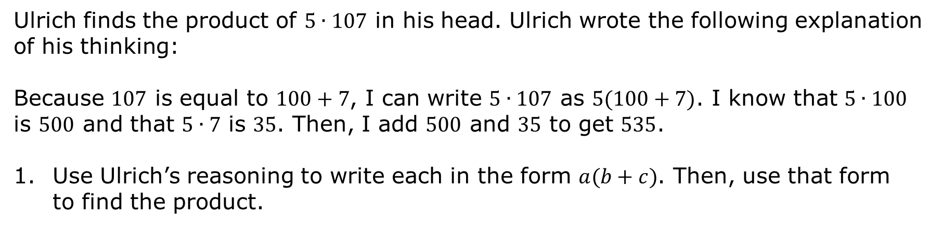
11.4.1 Warm-Up: Mental Math
Ulrich finds the product of $5∙107$ in his head. Ulrich wrote the following explanation of his thinking:
Because $107$ is equal to $100+7$, I can write $5∙107$ as $5(100+7)$. I know that $5∙100$ is $500$ and that $5∙7$ is $35$. Then, I add $500$ and $35$ to get $535$.
Use Ulrich’s reasoning to write each in the form $a(b+c)$. Then, use that form to find the product.
Multiplication | $$5∙104$$ | $$5∙97$$ | $$5∙130$$
$$a(b+c)$$
Product
volume 2, pg. 256

Slide 7

Exploration
volume 2, pg. 256

Slide 8
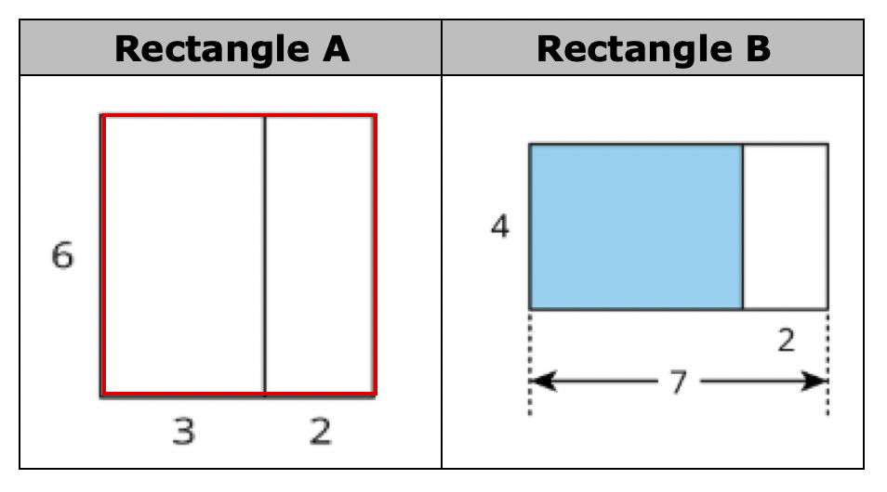
11.4.2 Exploration: Representing Area of a Rectangle
Work with your partner to answer the questions.
volume 2, pg. 256

Slide 9
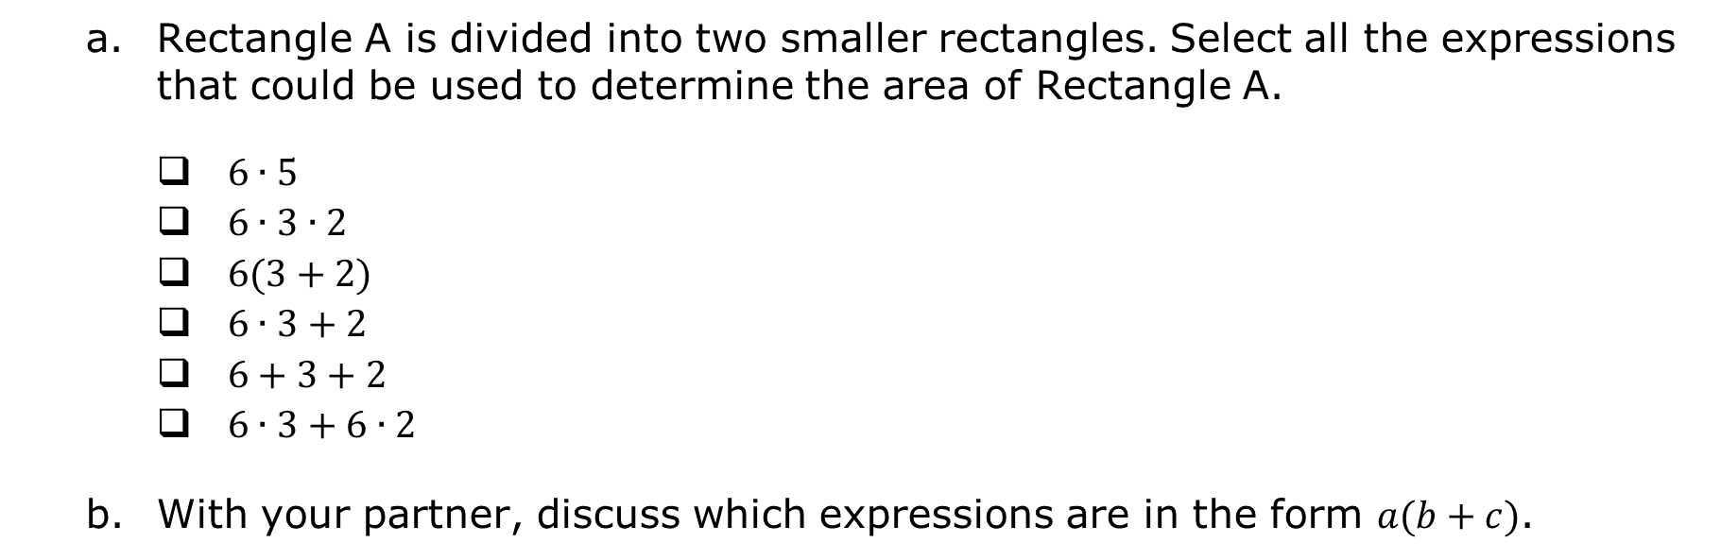
Rectangle A is divided into two smaller rectangles. Select all the expressions that could be used to determine the area of Rectangle A.
$6∙5$
$6∙3∙2$
$6(3+2)$
$6∙3+2$
$6+3+2$
$6∙3+6∙2$
With your partner, discuss which expressions are in the form $a(b+c)$.
volume 2, pg. 256

Slide 10
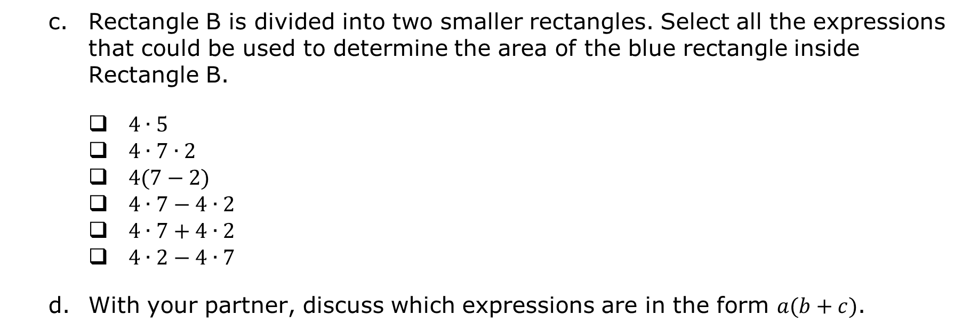
Rectangle B is divided into two smaller rectangles. Select all the expressions that could be used to determine the area of the blue rectangle inside Rectangle B.
$4∙5$
$4∙7∙2$
$4(7−2)$
$4∙7−4∙2$
$4∙7+4∙2$
$4∙2−4∙7$
With your partner, discuss which expressions are in the form $a(b+c)$.
volume 2, pg. 256

Slide 11
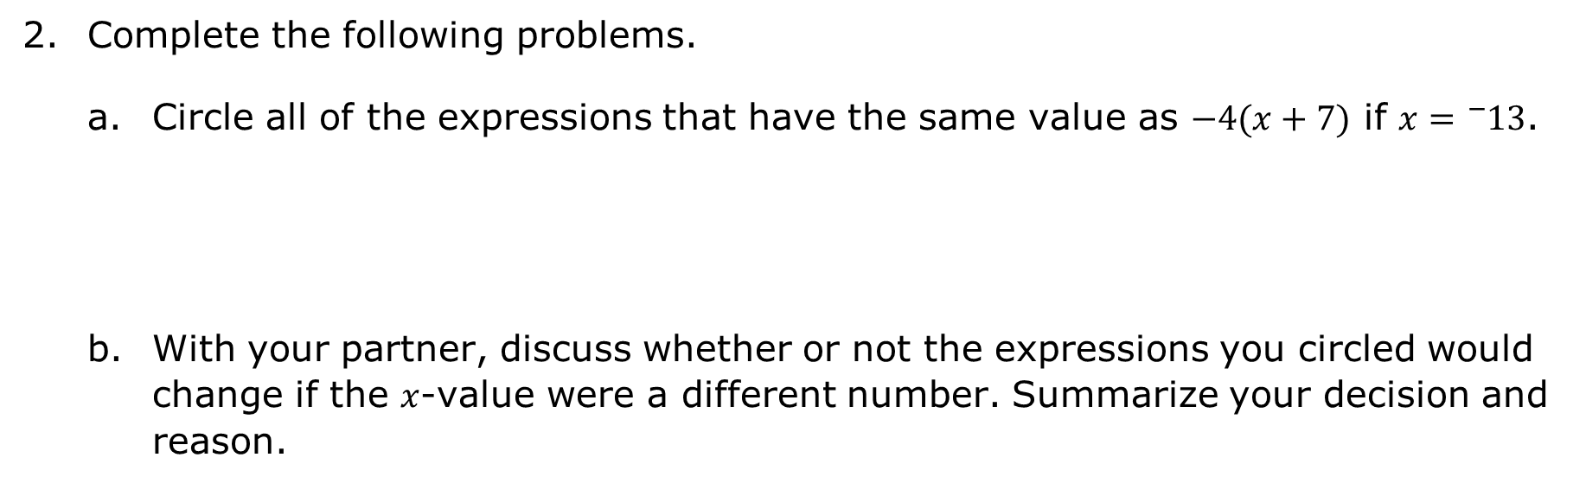
Complete the following problems.
Circle all of the expressions that have the same value as $−4(x+7)$ if $x={}_{}^{−}{13}$.
With your partner, discuss whether or not the expressions you circled would change if the $x$-value were a different number. Summarize your decision and reason.
$$−4x+7$$ | $$(x+7)∙−4$$ | $$−4x+−4∙7$$ | $$4(x−7)$$ | $${}_{}^{−}{28}−4x$$
volume 2, pg. 257

Slide 12

Guided Instruction
volume 2, pg. 258

Slide 13
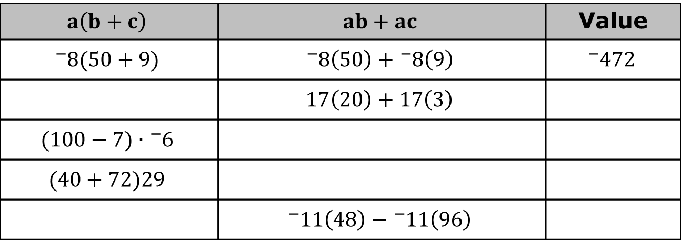
11.4.3 Guided Instruction: Applying Properties of Operations
The distributive property of multiplication over addition is a property that applies to all rational numbers. The distributive property “distributes” a factor to all terms within a set of parentheses.
Complete the table. The first row has been completed.
$$a\left(b+c\right)$$ | $$ab+ac$$ | Value
$${}_{}^{−}{8(50+9)}$$ | $${}_{}^{−}8\left(50\right)+{}_{}^{−}8\left(9\right)$$ | $${}_{}^{−}{472}$$
 | $$17\left(20\right)+17\left(3\right)$$
$$(100−7)∙{}_{}^{−}6$$
$$(40+72)29$$
 | $${}_{}^{−}{11}\left(48\right)−{}_{}^{−}{11}\left(96\right)$$
volume 2, pg. 258

Slide 14
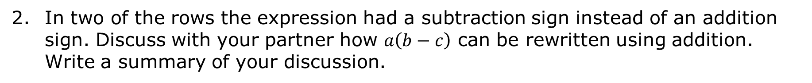
In two of the rows the expression had a subtraction sign instead of an addition sign. Discuss with your partner how $a\left(b−c\right)$ can be rewritten using addition. Write a summary of your discussion.
volume 2, pg. 258

Slide 15
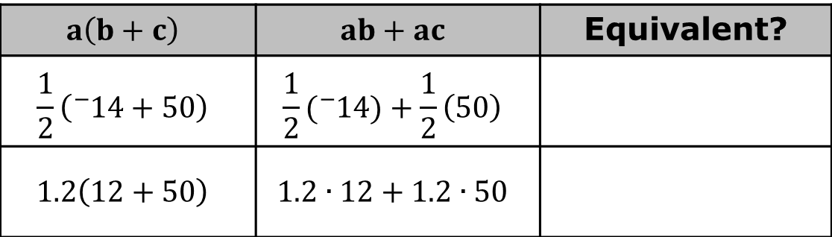
Use the expressions below to show that the distributive property of multiplication over addition works with rational numbers.
Mathematicians determine a property exists when expressions are equivalent, no matter what number is used. A property can then be used with variables.
$$a\left(b+c\right)$$ | $$ab+ac$$ | Equivalent?
$$\frac{1}{2}\left({}_{}^{−}{14+50}\right)$$ | $$\frac{1}{2}({}_{}^{−}{14)+\frac{1}{2}\left(50\right)}$$
$$1.2\left(12+50\right)$$ | $$1.2∙12+1.2∙50$$
Expressions are equivalent if they have the same value, no matter what number is substituted in for each of the variables.
volume 2, pg. 258

Slide 16

Write an equivalent expression for $8\left(x+2\right)$.
Write an equivalent expression for $\frac{1}{2}\left(x−16\right)$.
volume 2, pg. 258

Slide 17
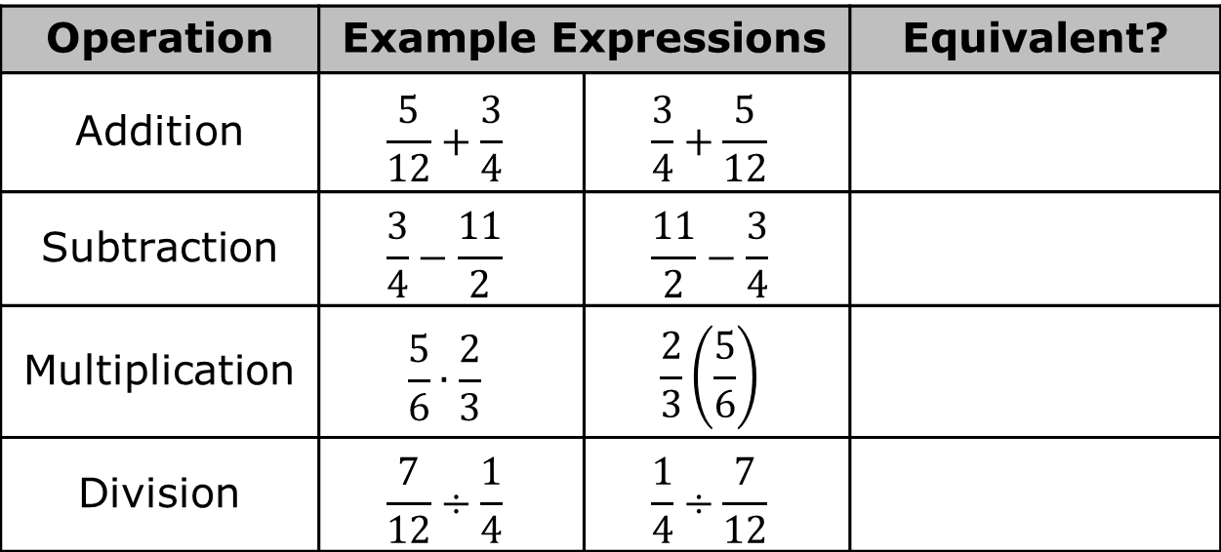
The commutative property states that the order in which an operation is performed does not change the value of the expression.
Use the pairs of expressions below to determine the operations for which the commutative property is true.
The commutative property only applies to ____ and ____.
Operation | Example Expressions |  | Equivalent?
Addition | $$\frac{5}{12}+\frac{3}{4}$$ | $$\frac{3}{4}+\frac{5}{12}$$
Subtraction | $$\frac{3}{4}−\frac{11}{2}$$ | $$\frac{11}{2}−\frac{3}{4}$$
Multiplication | $$\frac{5}{6}∙\frac{2}{3}$$ | $$\frac{2}{3}\left(\frac{5}{6}\right)$$
Division | $$\frac{7}{12}÷\frac{1}{4}$$ | $$\frac{1}{4}÷\frac{7}{12}$$
volume 2, pg. 259

Slide 18
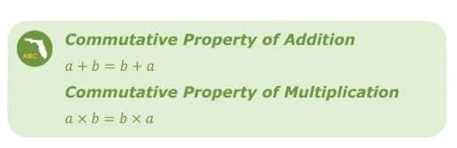
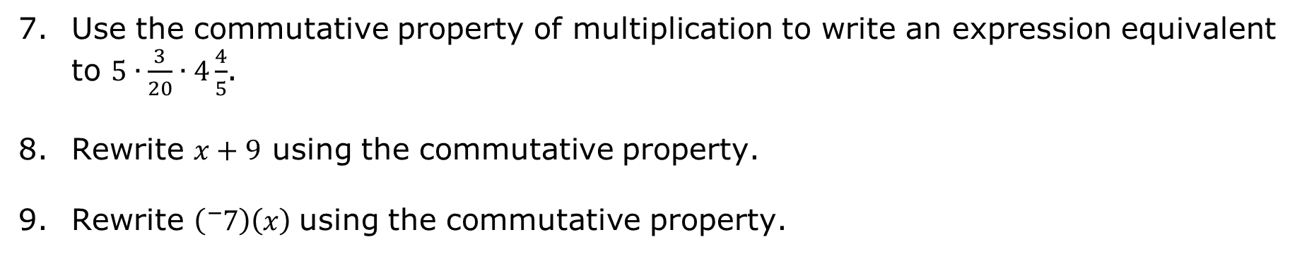
Use the commutative property of multiplication to write an expression equivalent to $5∙\frac{3}{20}∙4\frac{4}{5}$.
Rewrite $x+9$ using the commutative property.
Rewrite $\left({}_{}^{−}7\right)\left(x\right)$using the commutative property.
volume 2, pg. 259

Slide 19
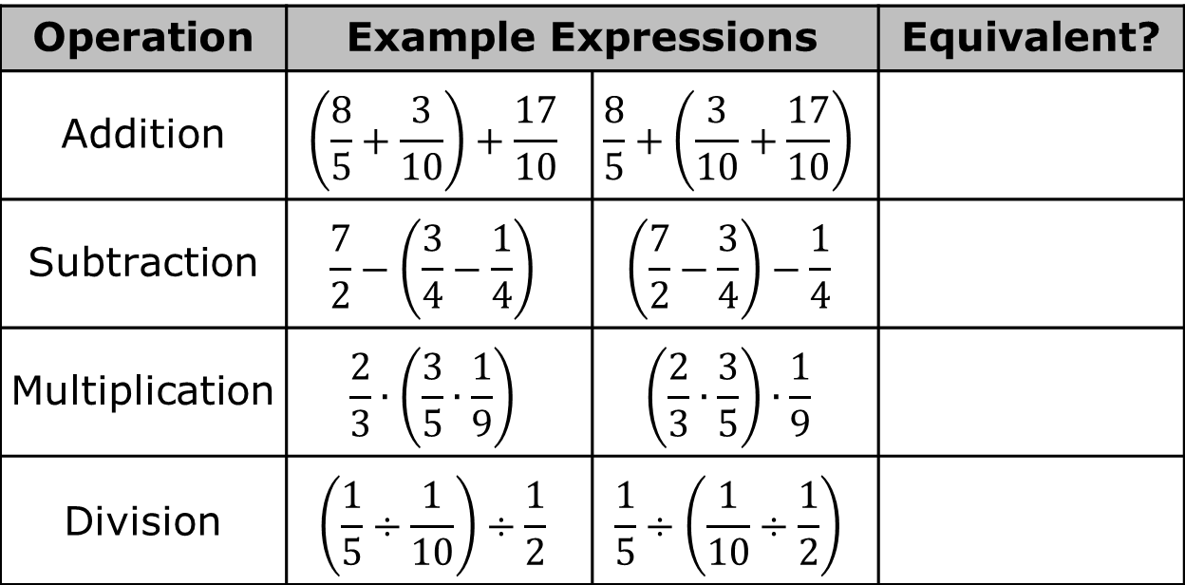
The associative property states that the way in which numbers are grouped does not change the value of the expression.
Use the pairs of expressions below to determine the operations for which the associative property is true.
The associative property only applies to ____ and ____.
Operation | Example Expressions |  | Equivalent?
Addition | $$\left(\frac{8}{5}+\frac{3}{10}\right)+\frac{17}{10}$$ | $$\frac{8}{5}+\left(\frac{3}{10}+\frac{17}{10}\right)$$
Subtraction | $$\frac{7}{2}−\left(\frac{3}{4}−\frac{1}{4}\right)$$ | $$\left(\frac{7}{2}−\frac{3}{4}\right)−\frac{1}{4}$$
Multiplication | $$\frac{2}{3}∙\left(\frac{3}{5}∙\frac{1}{9}\right)$$ | $$\left(\frac{2}{3}∙\frac{3}{5}\right)∙\frac{1}{9}$$
Division | $$\left(\frac{1}{5}÷\frac{1}{10}\right)÷\frac{1}{2}$$ | $$\frac{1}{5}÷\left(\frac{1}{10}÷\frac{1}{2}\right)$$
volume 2, pg. 260

Slide 20
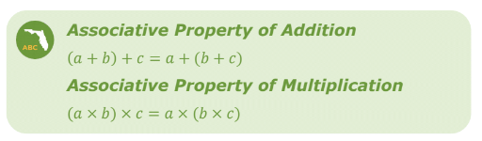
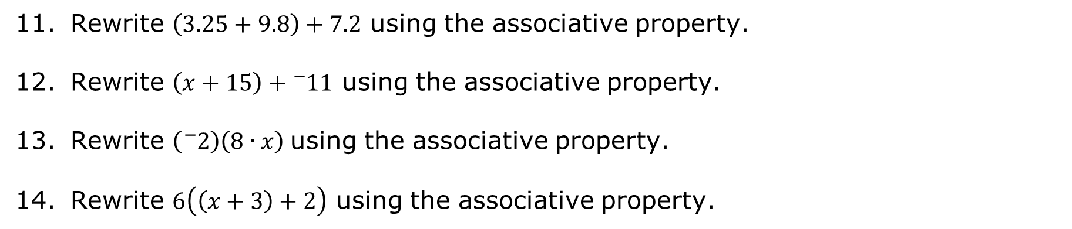
Rewrite $\left(3.25+9.8\right)+7.2$ using the associative property.
Rewrite $\left(x+15\right)+{}_{}^{−}{11}$ using the associative property.
Rewrite $\left({}_{}^{−}2\right)\left(8∙x\right)$using the associative property.
Rewrite $6\left(\left(x+3\right)+2\right)$ using the associative property.
volume 2, pg. 260

Slide 21

Wrap-Up
volume 2, pg. 261

Slide 22
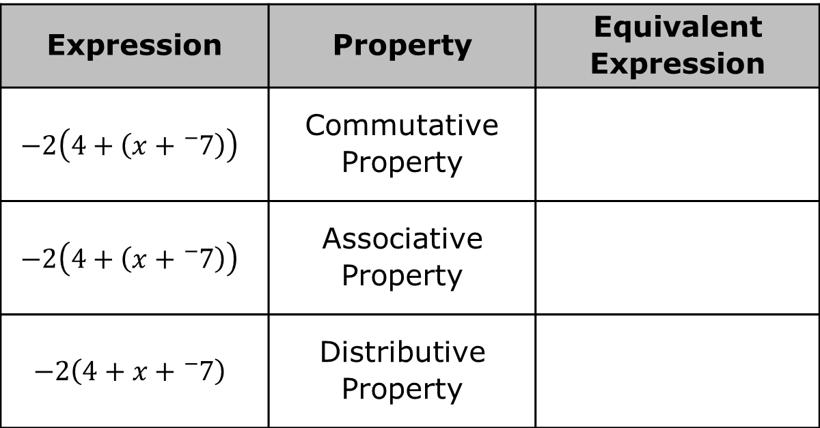
11.4.4 Wrap-Up: Ticket Out the Door
Write an equivalent expression that uses each given property to complete the table.
Expression | Property | Equivalent Expression
$$−2\left(4+\left(x+{}_{}^{−}7\right)\right)$$ | Commutative Property
$$−2\left(4+\left(x+{}_{}^{−}7\right)\right)$$ | Associative Property
$$−2\left(4+x+{}_{}^{−}7\right)$$ | Distributive Property
volume 2, pg. 261

